Slide 1

ORFEO ToolBox at CS-SI for Copernicus program
07/06/2017
Mickaël Savinaud
CS Image Processing and Toolbox manager
Orfeo Toolbox is not a black box
http://www.orfeo-toolbox.org
Notes:
Responsable présentation = SDH

Slide 2
Plan
CS SI – PDA department
OTB & Copernicus Program at CS SI
  OTB in Sentinel-2 PDGS
  OTB & MACCS/MAJA L2A Processor
  OTB & SNAP toolbox
  OTB & Sen2AGRI project
  OTB & RUS project
  OTB as a Service
OTB & RUGGED for Pleiades Orthorectification
Conclusion

Slide 3
CS-SI
Payload Data Application
120 people - Dual IT and Thematic skills
Image Procesing & Toolbox Team : 20 people (25% of PhD)
8 M€ turnover
Consultant & study
(Contract and project management, technical expertise, needs study, modeling, prototype…)
services
Research & Development
(Internal study, work experiences and thesis)
Prime contractor, Development & systems integration
( contract work, ready-made systems & COTS)
Training, Support and Maintenance
(customer support, technical support, operational conditions support, and training)

Slide 4
CS-SI
Image Geographic Application Department
  Ground Segment Image Processing chain: IPF S2, MACCS, Kalideos
  Ground Segment Image Quality: MPC S2, ICC Pleiades, VIQ, MPA S2
  Image Processing Tools Box: OTB, SNAP, RUGGED, CNES Common Tools
image processing expertise of earth observation ground station : acquisition, inventory, production, thematic and added-value image processing.
  PAAS -Geospatial Platform Technology: Geostorm
  Applications and Services activities
  Land, Environment, Energy, Defense: Saterre, S2Agri, PEPS
Applications and Information Systems Design and Engineering

Slide 5
Orfeo ToolBox in Sentinel-2 PDGS
TAS/ESA - Sentinel 2 Level-0 and Level-1 Instrument Processing Facility (IPF)
  Automatic production of large volume of Sentinel-2 L1c products.
  OTB in image processing module: cloud/water mask computing, resampling from location grid, radiometric corrections (deconvolution, image filtering, aberrant pixel interpolation).
TAS/ESA - Sentinel-2 Mission Performance Assessment (MPA):
  Resampling of image data
  Correlation between bands to detect misalignment.

Slide 6
Orfeo ToolBox & MACCS/MAJA L2A Processor
CNES - Multi-mission Atmospheric and Cloud Correction Software (MACCS)
  Processing multi-temporal and/or multi-spectral images to produce physical measurements
  Atmospheric corrections: AOT estimation, environment and slope correction
  Cloud, Cloud Shadow, Water and Snow detection
  Develop since end of 2009 with Venµs and Formosat (Landsat8, Spot4-5 and S2)

Slide 7
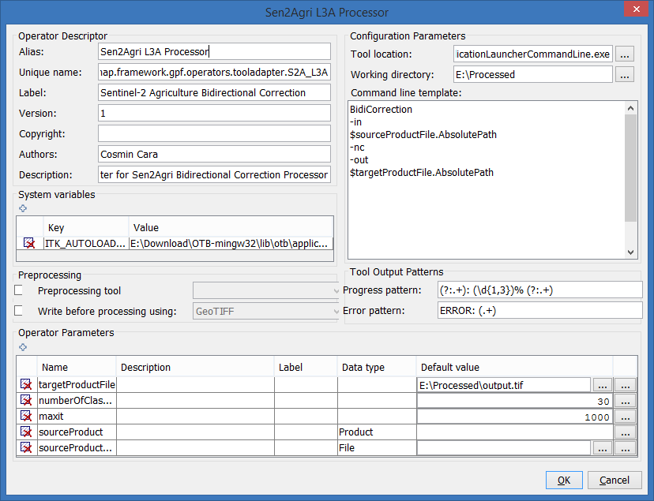
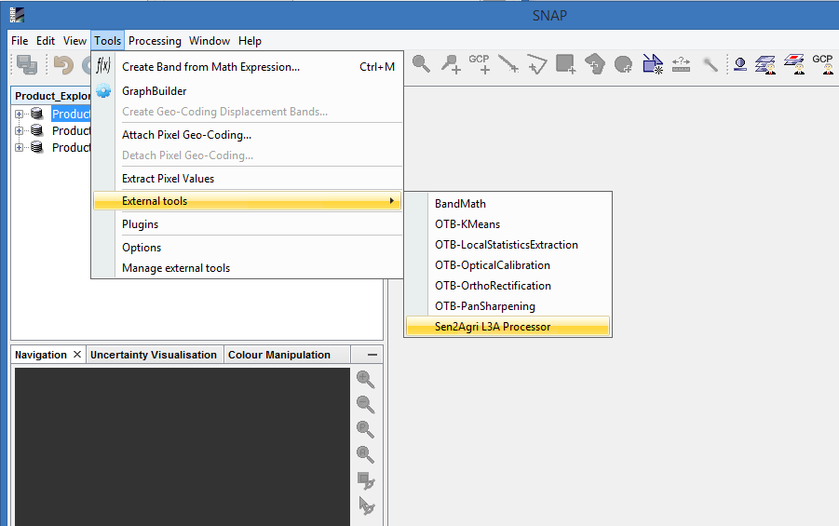
Orfeo ToolBox – SNAP toolbox
SNAP - Sentinel-2 ToolBox:
  set of visualization, analysis and processing tools for the exploitation of MSI data from Sentinel-2 mission.
  Re-use the components and the heritage of BEAM Toolbox
  Common framework and development with other Sx Toolbox -> SNAP
  Release of V6 at end of June
  OTB integration via the standard tool adapter and in SNAPPy

Slide 8
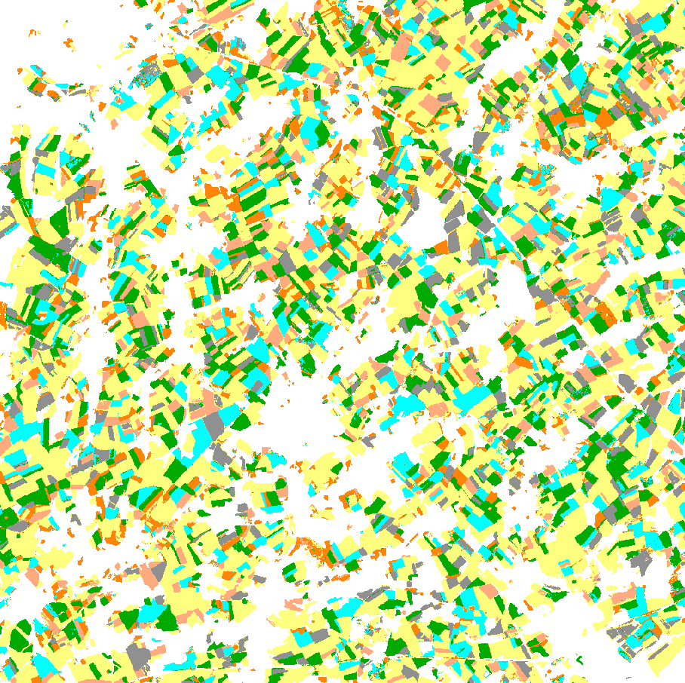
Orfeo ToolBox - Sentinel-2 end-users application
Sentinel-2 For Agriculture: www.esa-sen2agri.iorg
  Support definition and production of 4 new products and the related algorithm
  Provide an open source system to end-user
  R&D and operational image processing chains done with OTB
  Use Sentinel-2 L1C and LandSat8 L1T data
Composite product: BRDF correction and weighted average approach
LAI retrieval: based on otb-bv code
Dynamic crop mask and crop type: based on OTB classification framework
Crop type result over Belgium site
(S4-T5 + L8 times series)

Slide 9

Orfeo ToolBox & RUS project
RUS : http://RUS-Copernicus.eu
  OTB, SNAP, QGIS, ... available in VM with direct access to Copernicus data
  Funded by EC, managed by ESA, and operated by CSSI and its partners
Free access to a powerful computing environment with scalable VM and full support
Dedicated training face-to-face sessions and webinars for all users
For all users : students, trainers, researchers, decision-makers, general public
Efficient processing of large Sentinel datasets possible for any user

Slide 10
Orfeo ToolBox as a Service
Provide in a geo-spatial infrastructure:
  Processing services OTB based : Spatial Mosaic, BandMath, Classification
  Direct access to Sentinel 2 / L8 data (ESA data warehouse)
  Scalable thanks to Torque
  LIVE DEMO !

Slide 11
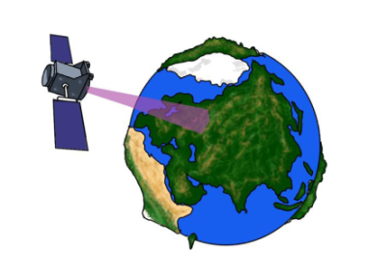

Orfeo ToolBox & RUGGED for Pleiades Orthorectification
OrthoTool = Python code for orthorectification
  Rely on FOSS : RUGGED and OTB
  Use Physical model for geolocation (OTB used RPC)
DEM
(SRTM1s)
PHR (DIMAP)
PHR (IMAGE)
Resampling Grid
Ortho image
Geometric Model Handling
Resampling
In progress:
  Quantitative analysis of results against OTB and COTS
  Use sensor modeling refining capabilities and 3D terrain modeling

Slide 12
CONCLUSION: R&D to Operational context
OTB is used at CS-SI as a development framework for image processing over large dataset
  Flexible: open source, bindings (python)…
  Completeness: many algorithms available
  Performance
  Maintainability: documentation, strong development rules, …
OTB is used at CS-SI for operational development with strong constraints
CS-SI proposes Training around OTB for developers or users
CS-SI is member of the PSC
CS-SI contribute some developments to OTB according to the new governance policy and license
CS-SI is sponsor of the OTB hackfest since 2015

